Slide 1

Jon Friskics ©2012

Slide 2

JavaScript library
  Developed by John Resig (http://ejohn.org/) in early 2006
Tagline - “write less, do more”
Encourages unobtrusive JavaScript
Available at www.jquery.com
  Development – 229kB uncompressed library
  Production – 31kB Minified and Gzipped library

Slide 3
Adding jQuery (current version 1.7.1)
  Since jQuery is just a bunch of JavaScript, we can include it just like we include any JavaScript file
  <script type=“text/javascript” src=“path/to/jquery.js”></script>
  Even better: Google’s CDN hosts the latest version of jQuery
    This is great because browsers cache files coming from the same location – if you always include jQuery from one place, it will likely be cached – this makes your scripts load quicker!
  <script type="text/javascript" src="http://ajax.googleapis.com/ajax/libs/jquery/1.7.1/jquery.min.js"></script>

Slide 4
  window.onload becomes $(document).ready();
    $(document).ready();

Slide 5
  window.onload becomes $(document).ready();
    $(document).ready(function() {
    // main JS code goes here
    });
    Translation – when the document is ready, execute the contents of an anonymous function

Slide 6
Core
  To execute a jQuery statement, use the function jQuery(), which is abbreviated as $() for convenience
  $(selector, [context])
    Pass $ a string that contains a selector
    That selector finds elements that match and returns them as something called a wrapped set
      A wrapped set is an object that contains other objects (array of objects)
    [context] allows you to narrow where the function looks for information

Slide 7
Selectors
  One of the core ideas behind jQuery is the use of CSS selectors to identify DOM nodes
  $(‘#response’).innerHTML = “<p>Hello</p>”;
  $(‘body div p’).css(‘color’,’red’);
  $(‘p:nth-child(3)’).hide();
  $(‘a:contains(“Jon Friskics”)’).css(‘font-size’,’5em’);
  Full docs: http://api.jquery.com/category/selectors/

Slide 8
<body>
<div>
<p></p>
<p></p>
<p></p>
</div>
<div>
<p></p>
</div>
</body>
$('body div p').css('color','red');
var body = document.getElementsByTagName('body');
var divs = body[0].getElementsByTagName('div');
for(var i=0; i<divs.length; i++) {
var paras = divs[i].getElementsByTagName('p');
for(var j=0; j<paras.length; j++) {
paras[j].color = 'red';
}
}
i | divs[i] | j | paras[j] before | paras[j] after
0

Slide 9

<body>
<div>
<p></p>
<p></p>
<p></p>
</div>
<div>
<p></p>
</div>
</body>
$('body div p').css('color','red');
var body = document.getElementsByTagName('body');
var divs = body[0].getElementsByTagName('div');
for(var i=0; i<divs.length; i++) {
var paras = divs[i].getElementsByTagName('p');
for(var j=0; j<paras.length; j++) {
paras[j].color = 'red';
}
}
i | divs[i] | j | paras[j] before | paras[j] after
0 | divs[0]

Slide 10
<body>
<div>
<p></p>
<p></p>
<p></p>
</div>
<div>
<p></p>
</div>
</body>
$('body div p').css('color','red');
var body = document.getElementsByTagName('body');
var divs = body[0].getElementsByTagName('div');
for(var i=0; i<divs.length; i++) {
var paras = divs[i].getElementsByTagName('p');
for(var j=0; j<paras.length; j++) {
paras[j].color = 'red';
}
}
i | divs[i] | j | paras[j] before | paras[j] after
0 | divs[0] | 0

Slide 11
<body>
<div>
<p></p>
<p></p>
<p></p>
</div>
<div>
<p></p>
</div>
</body>
$('body div p').css('color','red');
var body = document.getElementsByTagName('body');
var divs = body[0].getElementsByTagName('div');
for(var i=0; i<divs.length; i++) {
var paras = divs[i].getElementsByTagName('p');
for(var j=0; j<paras.length; j++) {
paras[j].color = 'red';
}
}
i | divs[i] | j | paras[j] before | paras[j] after
0 | divs[0] | 0 | paras[0] no color

Slide 12
<body>
<div>
<p style=‘color: red’></p>
<p></p>
<p></p>
</div>
<div>
<p></p>
</div>
</body>
$('body div p').css('color','red');
var body = document.getElementsByTagName('body');
var divs = body[0].getElementsByTagName('div');
for(var i=0; i<divs.length; i++) {
var paras = divs[i].getElementsByTagName('p');
for(var j=0; j<paras.length; j++) {
paras[j].color = 'red';
}
}
i | divs[i] | j | paras[j] before | paras[j] after
0 | divs[0] | 0 | paras[0] no color | paras[0] red color

Slide 13
<body>
<div>
<p style=‘color: red’></p>
<p></p>
<p></p>
</div>
<div>
<p></p>
</div>
</body>
$('body div p').css('color','red');
var body = document.getElementsByTagName('body');
var divs = body[0].getElementsByTagName('div');
for(var i=0; i<divs.length; i++) {
var paras = divs[i].getElementsByTagName('p');
for(var j=0; j<paras.length; j++) {
paras[j].color = 'red';
}
}
i | divs[i] | j | paras[j] before | paras[j] after
0 | divs[0] | 0 | paras[0] no color | paras[0] red color
0 | divs[0] | 1

Slide 14
<body>
<div>
<p style=‘color: red’></p>
<p></p>
<p></p>
</div>
<div>
<p></p>
</div>
</body>
$('body div p').css('color','red');
var body = document.getElementsByTagName('body');
var divs = body[0].getElementsByTagName('div');
for(var i=0; i<divs.length; i++) {
var paras = divs[i].getElementsByTagName('p');
for(var j=0; j<paras.length; j++) {
paras[j].color = 'red';
}
}
i | divs[i] | j | paras[j] before | paras[j] after
0 | divs[0] | 0 | paras[0] no color | paras[0] red color
0 | divs[0] | 1 | paras[1] no color

Slide 15
<body>
<div>
<p style=‘color: red’></p>
<p style=‘color: red’></p>
<p></p>
</div>
<div>
<p></p>
</div>
</body>
$('body div p').css('color','red');
var body = document.getElementsByTagName('body');
var divs = body[0].getElementsByTagName('div');
for(var i=0; i<divs.length; i++) {
var paras = divs[i].getElementsByTagName('p');
for(var j=0; j<paras.length; j++) {
paras[j].color = 'red';
}
}
i | divs[i] | j | paras[j] before | paras[j] after
0 | divs[0] | 0 | paras[0] no color | paras[0] red color
0 | divs[0] | 1 | paras[1] no color | paras[1] red color

Slide 16
<body>
<div>
<p style=‘color: red’></p>
<p style=‘color: red’></p>
<p></p>
</div>
<div>
<p></p>
</div>
</body>
$('body div p').css('color','red');
var body = document.getElementsByTagName('body');
var divs = body[0].getElementsByTagName('div');
for(var i=0; i<divs.length; i++) {
var paras = divs[i].getElementsByTagName('p');
for(var j=0; j<paras.length; j++) {
paras[j].color = 'red';
}
}
i | divs[i] | j | paras[j] before | paras[j] after
0 | divs[0] | 0 | paras[0] no color | paras[0] red color
0 | divs[0] | 1 | paras[1] no color | paras[1] red color
0 | divs[0] | 2

Slide 17
<body>
<div>
<p style=‘color: red’></p>
<p style=‘color: red’></p>
<p></p>
</div>
<div>
<p></p>
</div>
</body>
$('body div p').css('color','red');
var body = document.getElementsByTagName('body');
var divs = body[0].getElementsByTagName('div');
for(var i=0; i<divs.length; i++) {
var paras = divs[i].getElementsByTagName('p');
for(var j=0; j<paras.length; j++) {
paras[j].color = 'red';
}
}
i | divs[i] | j | paras[j] before | paras[j] after
0 | divs[0] | 0 | paras[0] no color | paras[0] red color
0 | divs[0] | 1 | paras[1] no color | paras[1] red color
0 | divs[0] | 2 | paras[2] no color

Slide 18
<body>
<div>
<p style=‘color: red’></p>
<p style=‘color: red’></p>
<p style=‘color: red’></p>
</div>
<div>
<p></p>
</div>
</body>
$('body div p').css('color','red');
var body = document.getElementsByTagName('body');
var divs = body[0].getElementsByTagName('div');
for(var i=0; i<divs.length; i++) {
var paras = divs[i].getElementsByTagName('p');
for(var j=0; j<paras.length; j++) {
paras[j].color = 'red';
}
}
i | divs[i] | j | paras[j] before | paras[j] after
0 | divs[0] | 0 | paras[0] no color | paras[0] red color
0 | divs[0] | 1 | paras[1] no color | paras[1] red color
0 | divs[0] | 2 | paras[2] no color | paras[2] red color

Slide 19
<body>
<div>
<p style=‘color: red’></p>
<p style=‘color: red’></p>
<p style=‘color: red’></p>
</div>
<div>
<p></p>
</div>
</body>
$('body div p').css('color','red');
var body = document.getElementsByTagName('body');
var divs = body[0].getElementsByTagName('div');
for(var i=0; i<divs.length; i++) {
var paras = divs[i].getElementsByTagName('p');
for(var j=0; j<paras.length; j++) {
paras[j].color = 'red';
}
}
i | divs[i] | j | paras[j] before | paras[j] after
0 | divs[0] | 0 | paras[0] no color | paras[0] red color
0 | divs[0] | 1 | paras[1] no color | paras[1] red color
0 | divs[0] | 2 | paras[2] no color | paras[2] red color
1

Slide 20
<body>
<div>
<p style=‘color: red’></p>
<p style=‘color: red’></p>
<p style=‘color: red’></p>
</div>
<div>
<p></p>
</div>
</body>
$('body div p').css('color','red');
var body = document.getElementsByTagName('body');
var divs = body[0].getElementsByTagName('div');
for(var i=0; i<divs.length; i++) {
var paras = divs[i].getElementsByTagName('p');
for(var j=0; j<paras.length; j++) {
paras[j].color = 'red';
}
}
i | divs[i] | j | paras[j] before | paras[j] after
0 | divs[0] | 0 | paras[0] no color | paras[0] red color
0 | divs[0] | 1 | paras[1] no color | paras[1] red color
0 | divs[0] | 2 | paras[2] no color | paras[2] red color
1 | divs[1]

Slide 21
<body>
<div>
<p style=‘color: red’></p>
<p style=‘color: red’></p>
<p style=‘color: red’></p>
</div>
<div>
<p></p>
</div>
</body>
$('body div p').css('color','red');
var body = document.getElementsByTagName('body');
var divs = body[0].getElementsByTagName('div');
for(var i=0; i<divs.length; i++) {
var paras = divs[i].getElementsByTagName('p');
for(var j=0; j<paras.length; j++) {
paras[j].color = 'red';
}
}
i | divs[i] | j | paras[j] before | paras[j] after
0 | divs[0] | 0 | paras[0] no color | paras[0] red color
0 | divs[0] | 1 | paras[1] no color | paras[1] red color
0 | divs[0] | 2 | paras[2] no color | paras[2] red color
1 | divs[1] | 0

Slide 22
<body>
<div>
<p style=‘color: red’></p>
<p style=‘color: red’></p>
<p style=‘color: red’></p>
</div>
<div>
<p></p>
</div>
</body>
$('body div p').css('color','red');
var body = document.getElementsByTagName('body');
var divs = body[0].getElementsByTagName('div');
for(var i=0; i<divs.length; i++) {
var paras = divs[i].getElementsByTagName('p');
for(var j=0; j<paras.length; j++) {
paras[j].color = 'red';
}
}
i | divs[i] | j | paras[j] before | paras[j] after
0 | divs[0] | 0 | paras[0] no color | paras[0] red color
0 | divs[0] | 1 | paras[1] no color | paras[1] red color
0 | divs[0] | 2 | paras[2] no color | paras[2] red color
1 | divs[1] | 0 | paras[0] no color

Slide 23
<body>
<div>
<p style=‘color: red’></p>
<p style=‘color: red’></p>
<p style=‘color: red’></p>
</div>
<div>
<p style=‘color: red’></p>
</div>
</body>
$('body div p').css('color','red');
var body = document.getElementsByTagName('body');
var divs = body[0].getElementsByTagName('div');
for(var i=0; i<divs.length; i++) {
var paras = divs[i].getElementsByTagName('p');
for(var j=0; j<paras.length; j++) {
paras[j].color = 'red';
}
}
i | divs[i] | j | paras[j] before | paras[j] after
0 | divs[0] | 0 | paras[0] no color | paras[0] red color
0 | divs[0] | 1 | paras[1] no color | paras[1] red color
0 | divs[0] | 2 | paras[2] no color | paras[2] red color
1 | divs[1] | 0 | paras[0] no color | paras[0] red color

Slide 24
<body>
<div>
<p style=‘color: red’></p>
<p style=‘color: red’></p>
<p style=‘color: red’></p>
</div>
<div>
<p style=‘color: red’></p>
</div>
</body>
$('body div p').css('color','red');
var body = document.getElementsByTagName('body');
var divs = body[0].getElementsByTagName('div');
for(var i=0; i<divs.length; i++) {
var paras = divs[i].getElementsByTagName('p');
for(var j=0; j<paras.length; j++) {
paras[j].color = 'red';
}
}
OR JUST THIS!!!
i | divs[i] | j | paras[j] before | paras[j] after
0 | divs[0] | 0 | paras[0] no color | paras[0] red color
0 | divs[0] | 1 | paras[1] no color | paras[1] red color
0 | divs[0] | 2 | paras[2] no color | paras[2] red color
1 | divs[1] | 0 | paras[0] no color | paras[0] red color

Slide 25
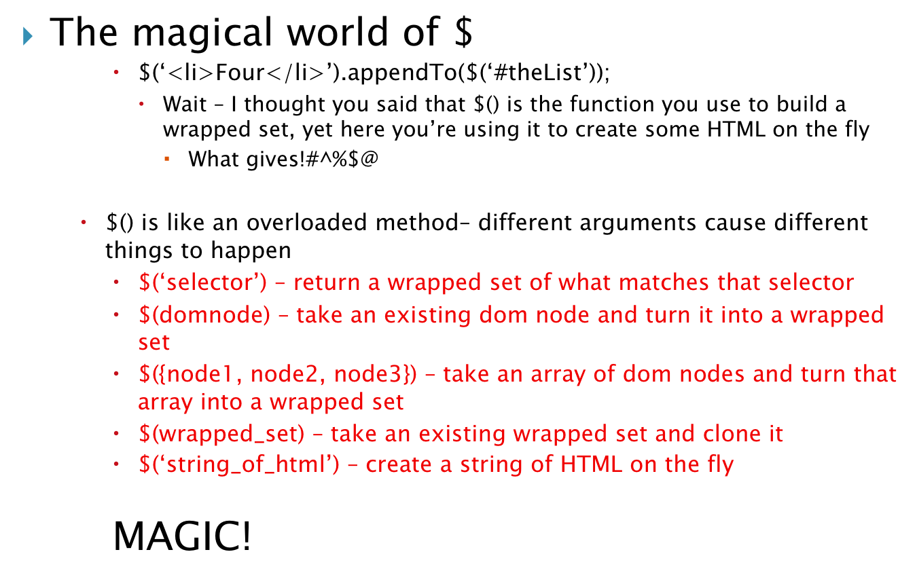

Slide 26
$(document).ready(function() {
// script continues here
});
This works because it satisfies one of the argument sets of $()
  $(domnode) – take an existing dom node and turn it into a wrapped set
All of your jQuery scripts should start out like this

Slide 27

Callback Function
  The function that executes in response to another method being called
Chaining
  Executing multiple methods in the same line of code such that method A returns a JavaScript object that method B uses as an argument until all methods have been executed

Slide 28
Chaining
  jQuery is designed so that chained methods always refer back to the original (although modified) wrapped set
    Instead of this:
      var hide_this_element = $(‘#hideIt’);
      hide_this_element.fadeOut();
      hide_this_element.addClass(‘hidden’);
    We can write this:
      $(‘#hideIt’).fadeOut().addClass(‘hidden’);
        This will capture <element id=“hideIt”>, fade it out, and then add a class to it called “removed”

Slide 29

Many jQuery functions accept individual parameters OR a single JavaScript object
Use a JavaScript objects whenever possible!
var myObject = {
property1:‘property1value’,
property2:‘property2value’,
method1: function({ }),
property3:‘property3value’
};

Slide 30

Ajax
  jQuery has several Ajax functions
    $.ajax([options])
      Options get passed in as a generic JavaScript object
        url – URL defining the requested file
        type – GET, POST
        dataType – XML, HTML, JSON
        timeout – number in milliseconds after which the request times out and errors
        beforeSend – callback function that executes before xhr.send()
        error – callback function that executes if the request fails
        success – callback function that executes if the request succeeds
        complete – callback function that executes when the request is complete
        data – specifies data sent to the server
        contentType – sets request headers, default is application/x-www-form-urlencoded (isn’t that convenient?)

Slide 31
Ajax
  jQuery has several Ajax functions
    $.ajax([options])
      var ajaxOptionsObject = {
      url: ‘get_this.html’,
      type: ‘get’,
      dataType: ‘xml’,
      error: errorMessage,
      success: displayResponse,
      data: null
      }
      $.ajax(ajaxOptionsObject);

Slide 32
Ajax Shorthand
  $.get(url[, data][, success])
    Equivalent to:
      $.ajax({
      url: ‘get_this.html’,
      data: null,
      success: displayResponse
      });
      $.get(‘test.html’), function(data) {
      $(‘.result’).html(data);
      });
      What does this do?????

Slide 33
Ajax Shorthand
  .load(url[, data][, success])
    Equivalent to:
      $.ajax({
      url: ‘get_this.html’,
      data: null,
      success: displayResponse
      });
  How is this different from $.get?
    $.get returns an XHR object and is a global function
    .load() returns a jQuery object and is just a method
      Results of load() can be used when chaining

Slide 34
Ajax Shorthand
  .load(url[, data][, success])
    Equivalent to:
      $.ajax({
      url: ‘get_this.html’,
      data: null,
      success: displayResponse
      });
    $(‘.result’).load(‘test.html’);
      What will this do?

Slide 35
jQuery Events
.bind(‘event_name’,callback)
  $(‘a’).bind(‘click’,function(e) {
  $(‘#info’).load(this.href);
  e.preventDefault();
  }

Slide 36
jQuery Events
trigger(event_name)
  Used to trigger an event listener that has already been created with bind() WITHOUT input from the user
  $(“a”).bind(‘click’,function() {
  $(this).addClass(“selected”);
  });
  $(“a”).trigger(‘click’);

Slide 37
jQuery Events
toggle(listenerOdd, listenerEven)
  $(“a”).toggle(function() {
  $(this).addClass(“selected”);
  },function() {
  $(this).removeClass(“selected”);
  });
  What does this do?

Slide 38
jQuery Events
toggle(listenerOdd, listenerEven)
  $(“a”).toggle(function() {
  $(this).addClass(“selected”);
  },function() {
  $(this).removeClass(“selected”);
  });
  Practice visually breaking the pieces down

Slide 39
References
  Bibeault, B., Katz, Y. jQuery In Action. 2008, Manning: Greenwich.
  Chaffer, J., Swedberg, K. jQuery Reference Guide. 2007, Packt Publishing:Birmingham.
  www.jquery.com

